Slide 1
The New healthcare Consumerism
Brainstorming with
Jane Sarasohn-Kahn, MA (Econ.), MHSa
Think-Health LLC & Health populi blog
17 November 2023
1

Slide 2
The New healthcare Consumerism our roadmap
Tracking the journey from patient to consumer
Heath @ Retail – a trip from Florence, Italy to Main Street, USA
The evolving retail health map (hint: don’t blink!)
The retail health mindset and landscape – future drivers and prospects
Brainstorming…

Slide 3
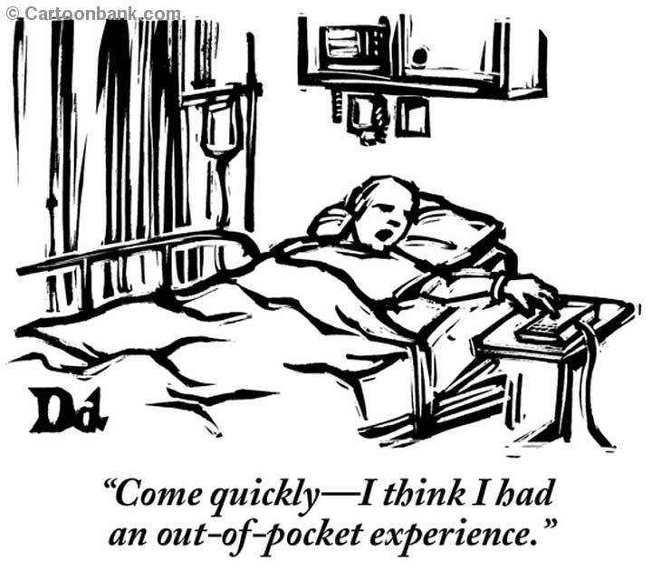
The Patient Is the Payor

Slide 4
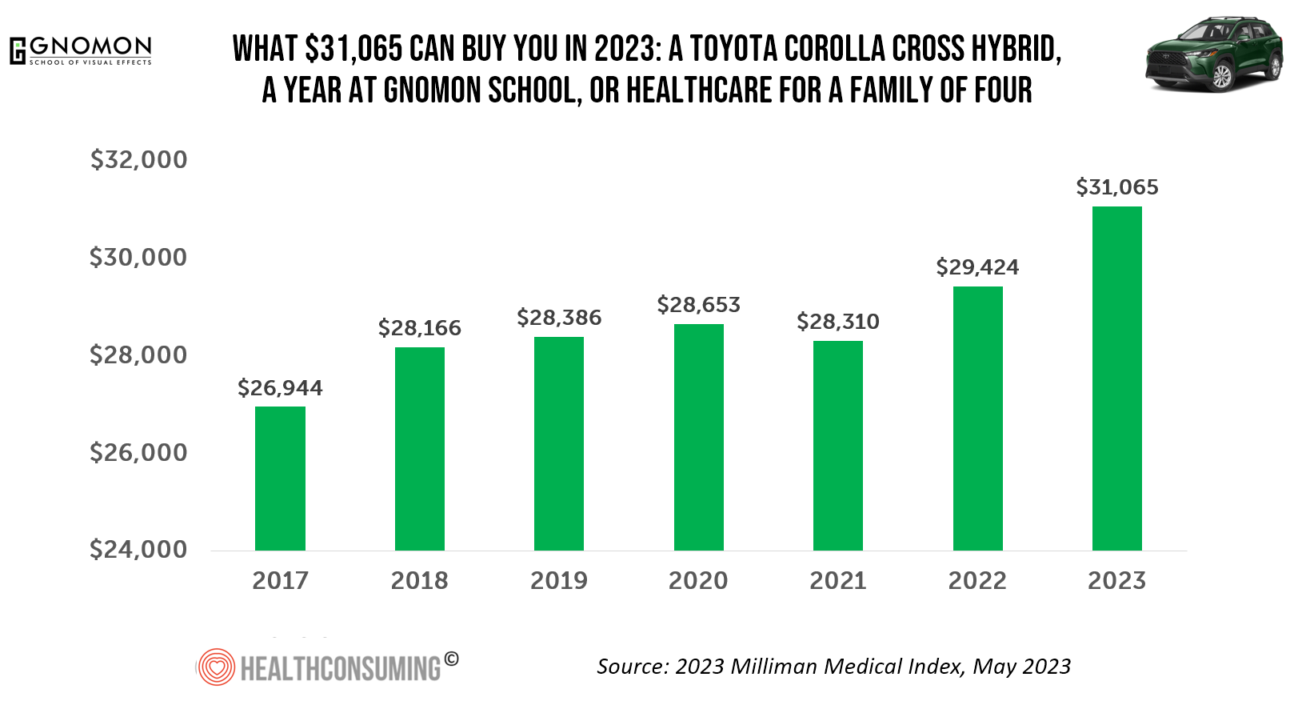
4

Slide 5
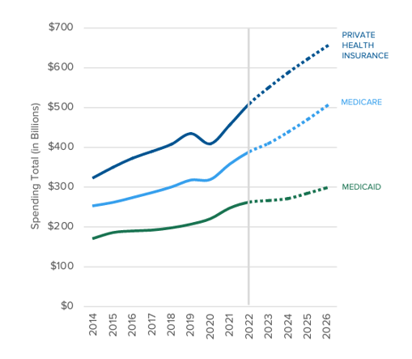
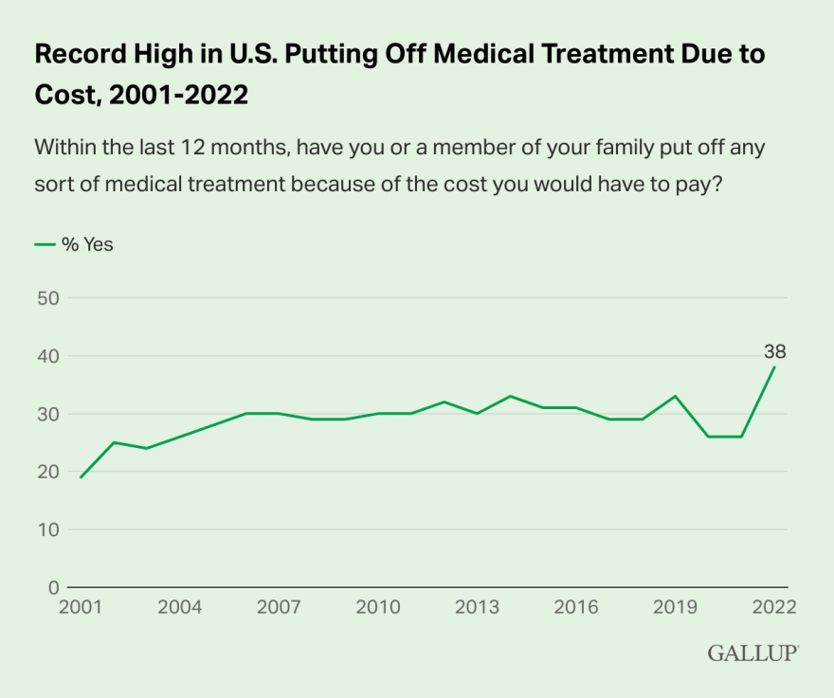
Unaffordability suppresses demand for health care, including prescription drugs
Sources: Centers for Medicare and Medicaid Services (CMS), National Health Expenditures, 2019-2028;
Record High in U.S. Put Off Medical Care Due to Cost in 2022, Gallup, January 17, 2023

Slide 6
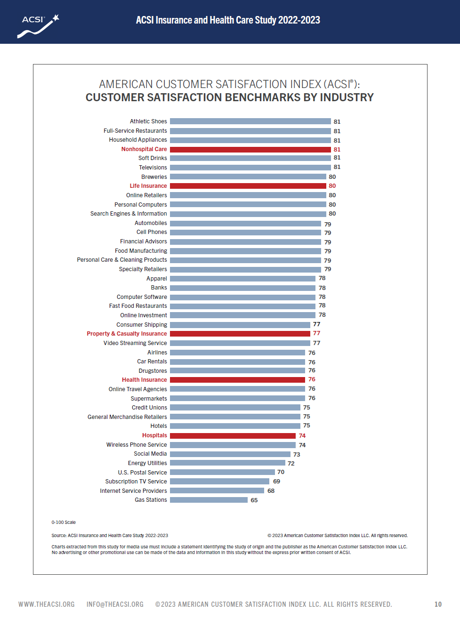
6

Slide 7
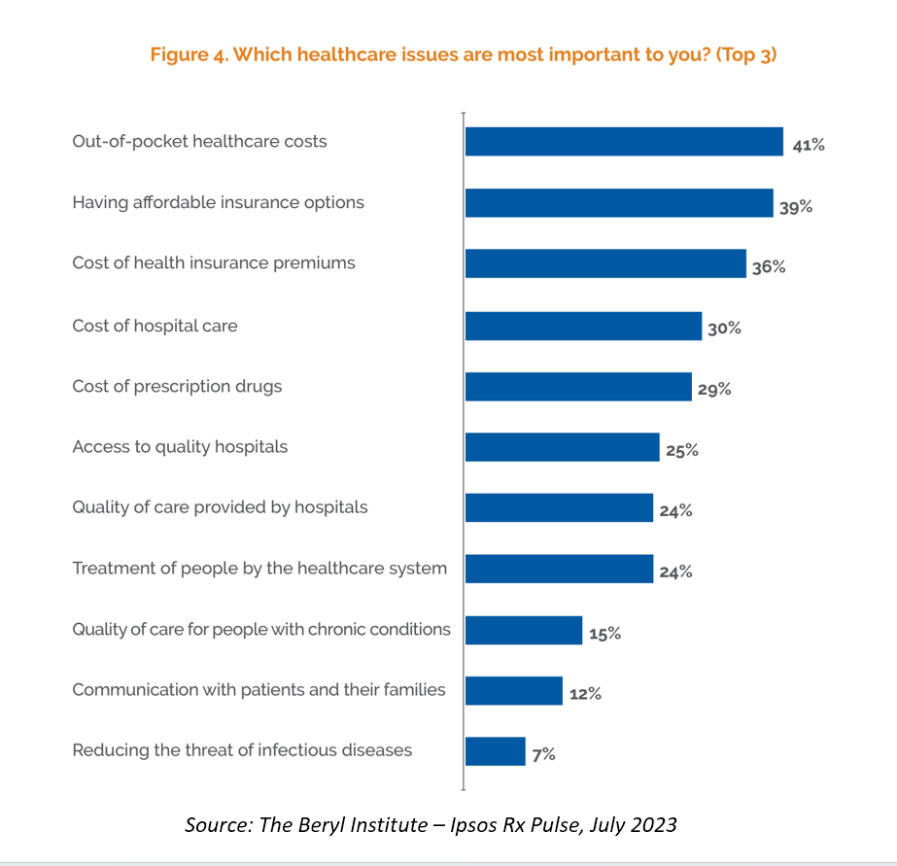
7

Slide 8
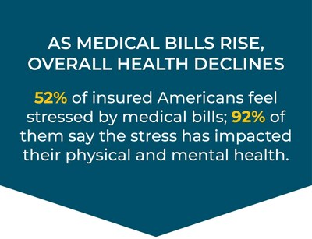
The direct Relationship between medical bills, financial stress and health
1 in 3 consumers say that out-of-pocket costs and deductibles (31%) are unaffordable
1 in 2 U.S. consumers said that in the last six months paying for medical bills has been stressful, esp. among
Younger people
People of color
Those with a credit score $≤$669
After receiving unexpected medical bill, 22% said it makes them “never want to go to the doctor again”
Among various health-related scenarios,
1/3 said the cost of an unexpected medical bill most stressful scenario
Only 13% said the same about the cost of having a sick family member
In past year, 1 in 5 Americans received collection notices from providers
Of those, two-thirds felt more negative about their provider.
Source: Healthcare Payments and Financial Disparities Study, PayMedix June 2023

Slide 9
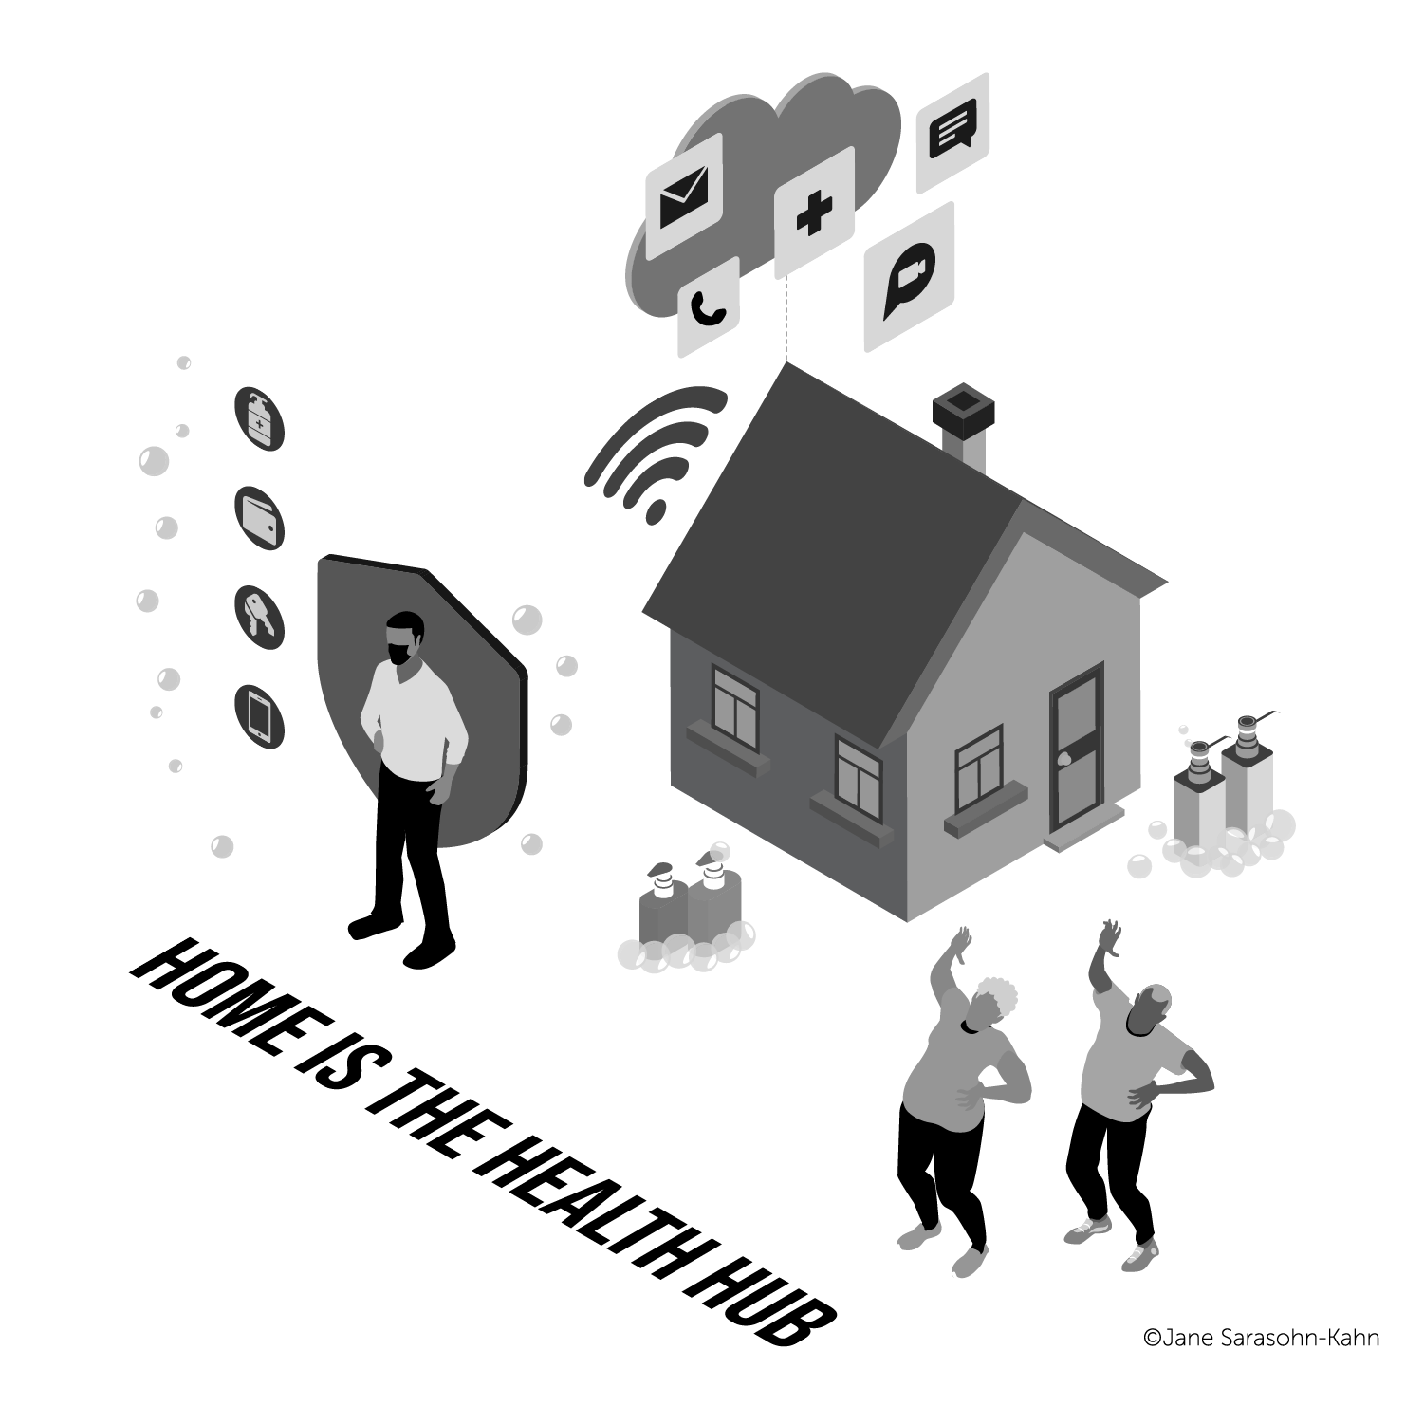
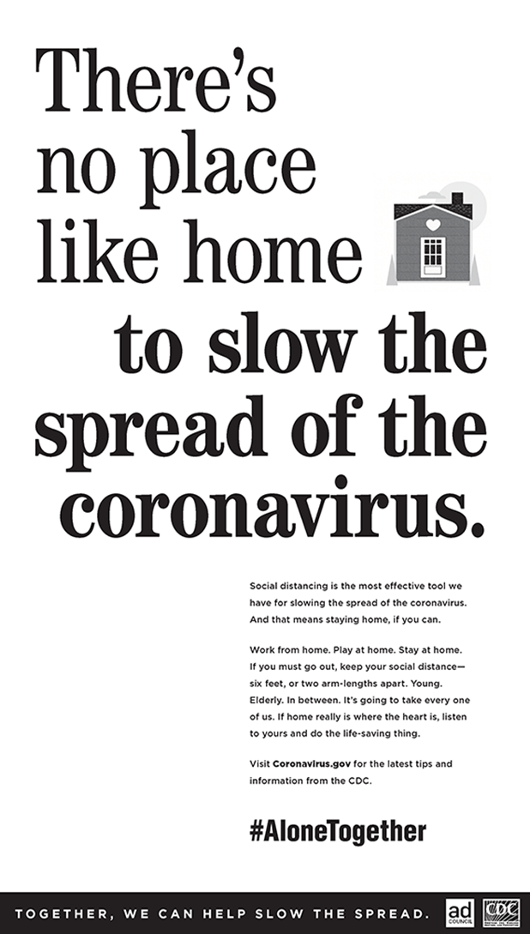
Notes:
How has this translated to individual consumers, this home as health hub phenomenon?

Slide 10
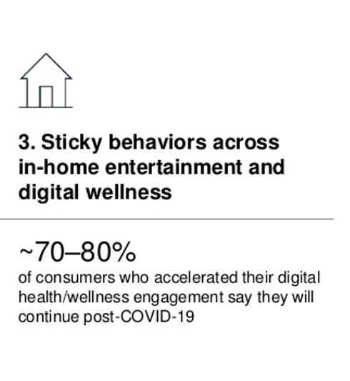
DIY healthcare in the pandemic → Radical Self-Care Covid-19 accelerated consumers’ self-care trends
Sources: Adapted from Radical Self-Care and the Changing Store Environment, Kantar, September
21, 2020; US consumer sentiment during the coronavirus crisis, McKinsey, March 24, 2021
Notes:
Another DIY life-flow for people was taking on more self-care and really more radical self care. We saw sales of ancestry and DNA kits increase in 2020, more attention to vitamins minerals and supplements to address immunity and brain health, and sleep as medicine…also greater attention to connected fitness and wearable technology….

Slide 11
Heath @ Retail – a trip from Florence, Italy
to Main Street, USA (or “K” Street, DC)
bUt What is “Retail health?”
It used to be the pharmacy…

Slide 12
Self-care in the renaissance…
Farmaceutica di Santa Maria Novella, c 1612
The first “retail pharmacy,” in Florence, Italy –
still operating, now with ecommerce channel

Slide 13
CVS, Store #10685, 675 “K” St., NW, Washington DC 20001

Slide 14
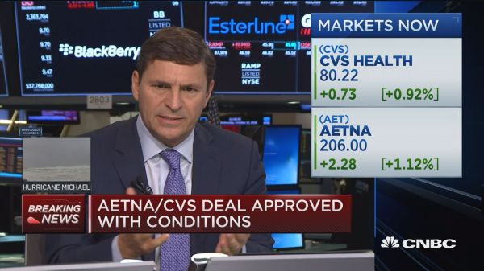
CVS/health + Aetna merger approved by DoJ,
10th October 2018

Slide 15
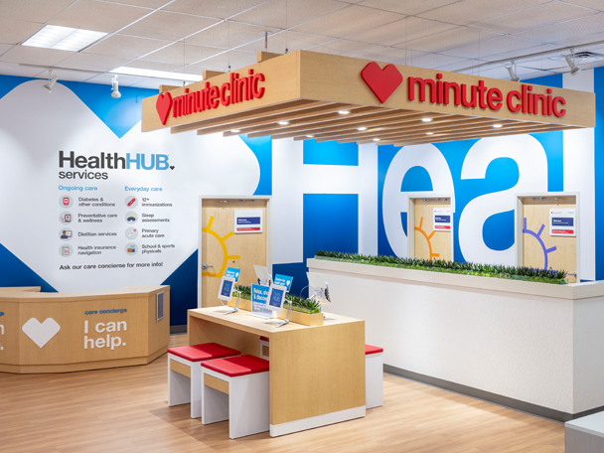
“Transforming the consumer health care experience creating a new front door to health care. HealthHUB locations are helping to elevate the store into a convenient neighborhood health care destination that brings easier access to better care at a lower cost.”
Alan Lotvin, Chief Transformation Officer, CVS/health
February 2019

Slide 16
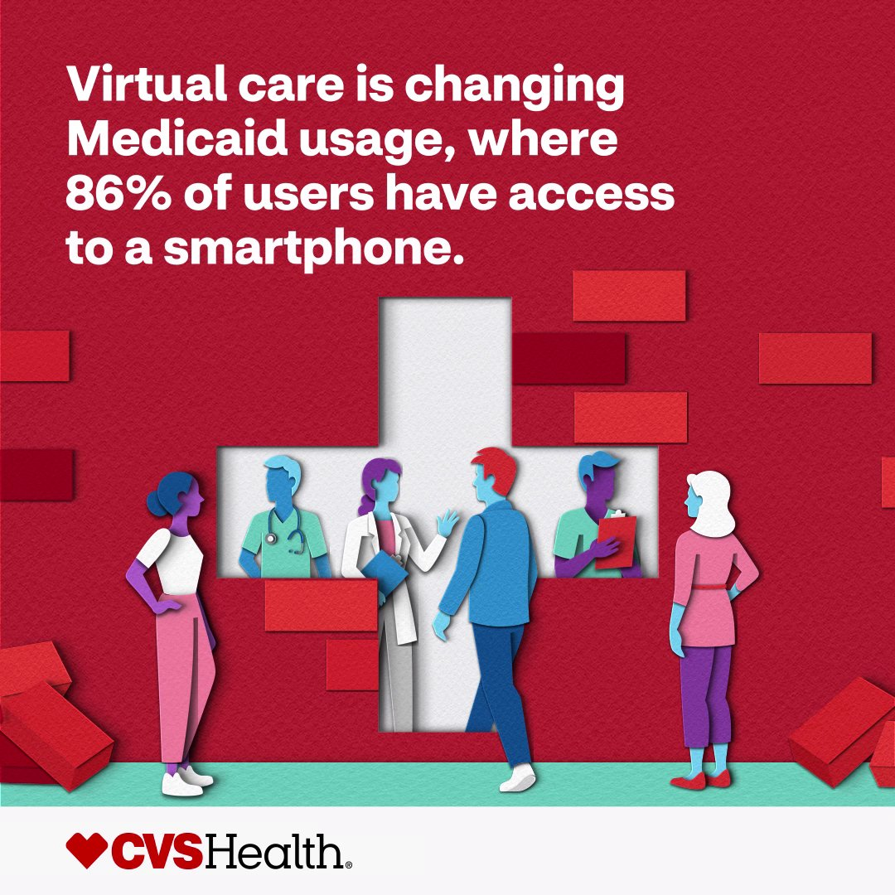
From to digital front doors…
goes omnichannel
a new front door
16

Slide 17
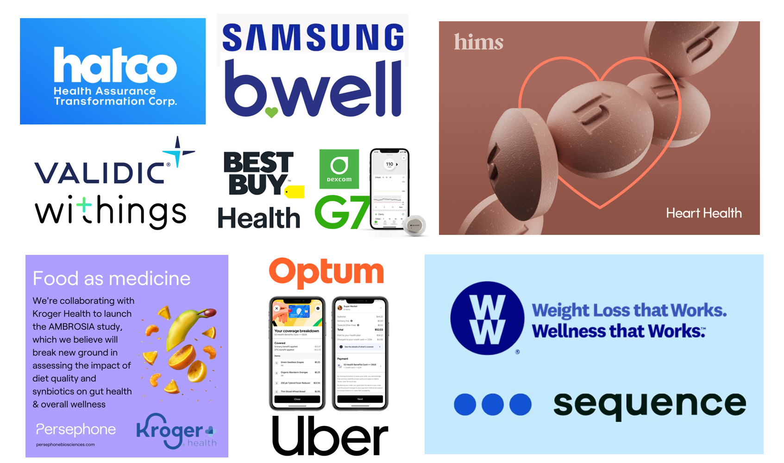
One week of retail health news in October 2023 (don’t blink!)
17

Slide 18
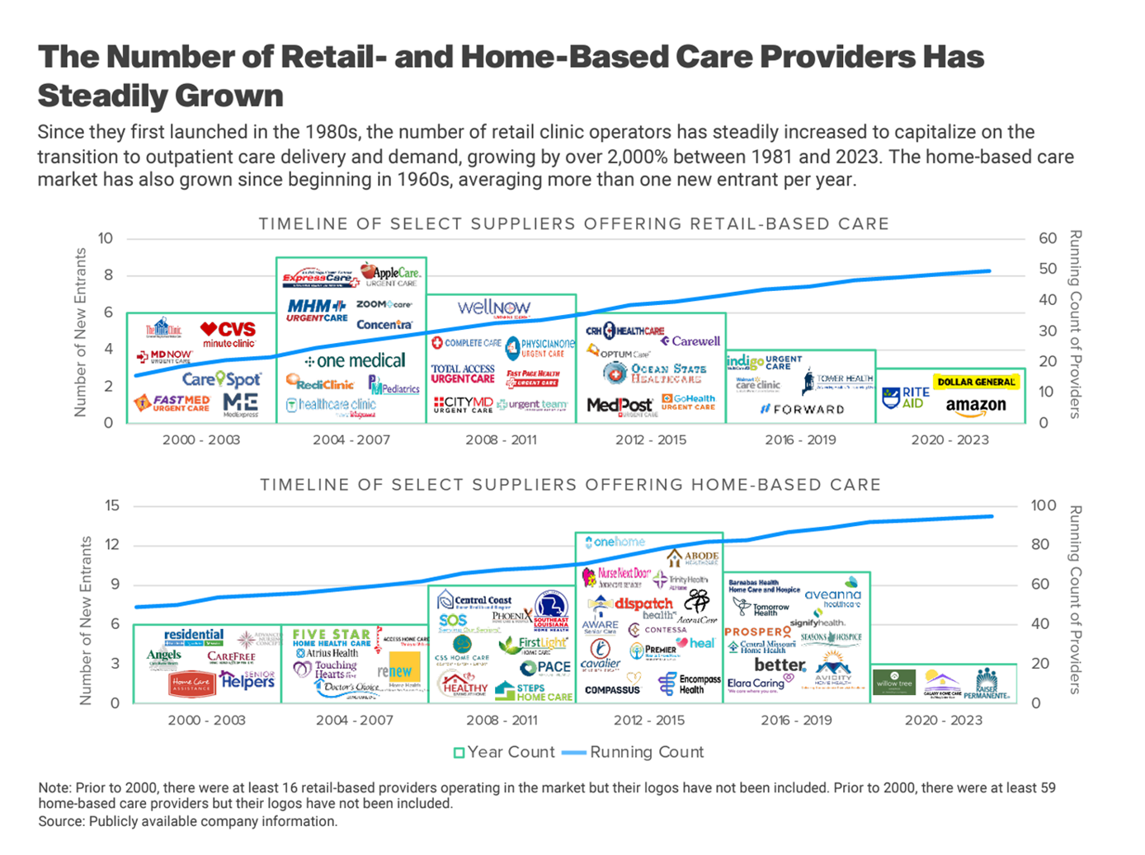
18

Slide 19
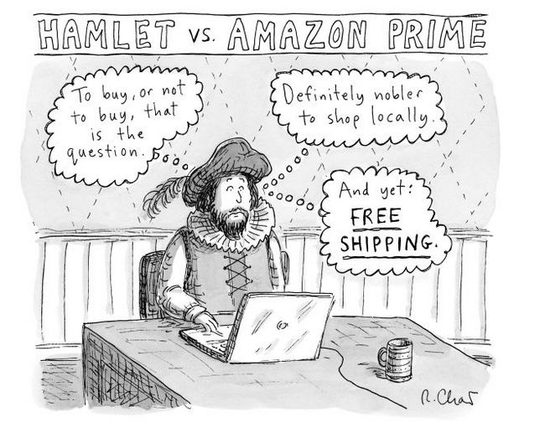
19

Slide 20
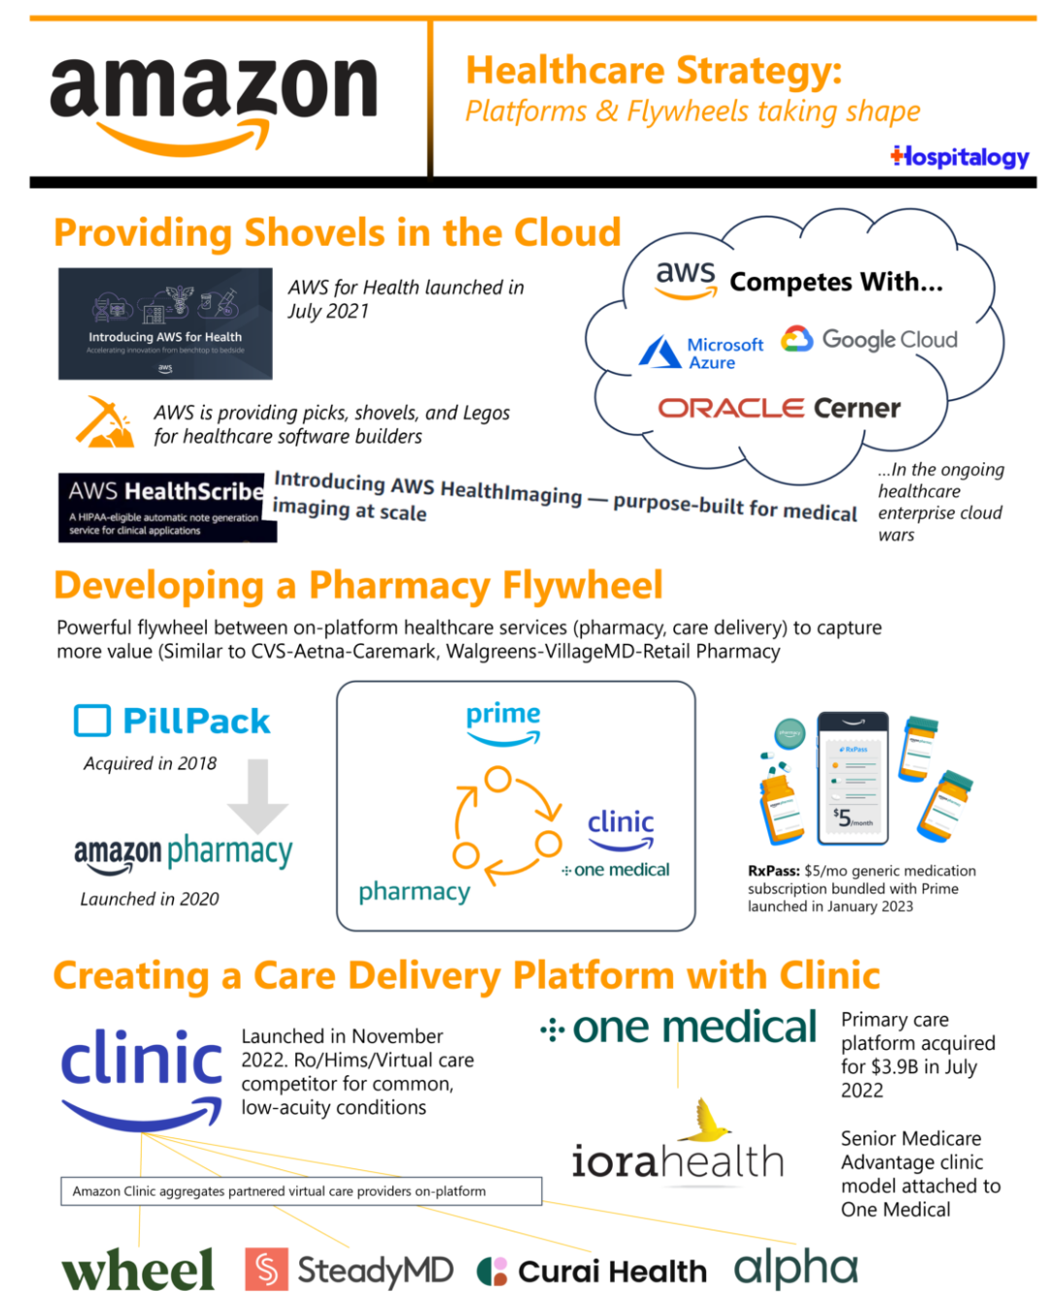
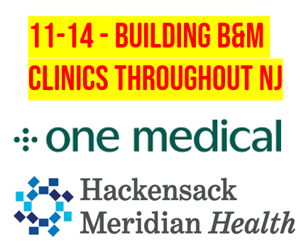
And don’t forget about…
‘s attributes…
A huge and loyal user base
Provision of hybrid clinical care
Deep pockets and long-term lens
A digital front door for health
One-stop shopping for employers…

Slide 21
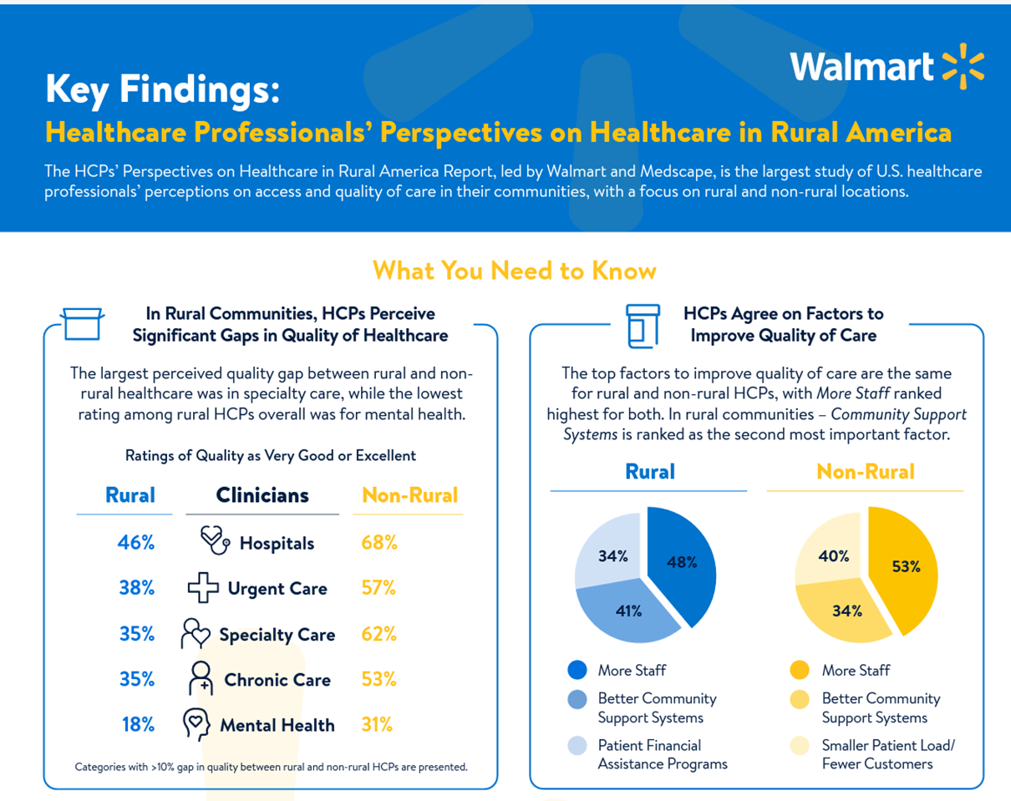
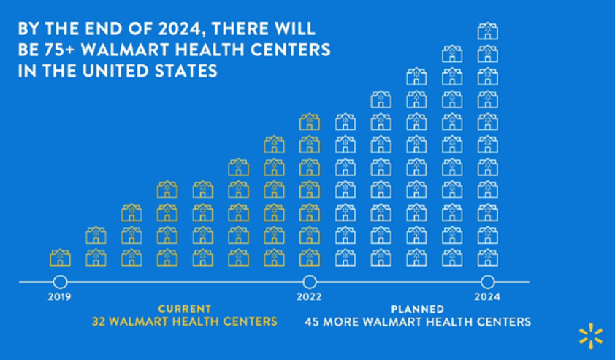
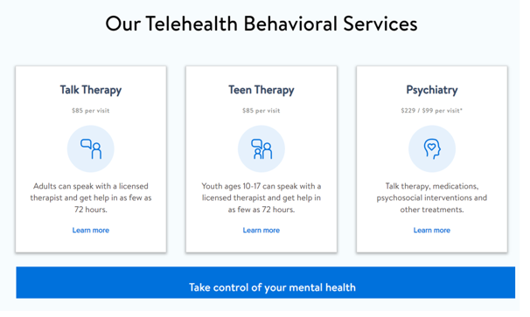
Walmart evolving into health care provider and potentially Payvider
3 more ways Walmart impacts
Americans’ health & wellness
\ Access to food
Affordability of products
Consumer awareness of
healthy products
Source: Walmart Health Nearly Doubles in Size with Launch Into Two New States in 2024, Walmart press release, March
2, 2023; Walmart Healthcare Professionals’ Perspectives on Healthcare in Rural America, Walmart + Medscape study, 2022

Slide 22
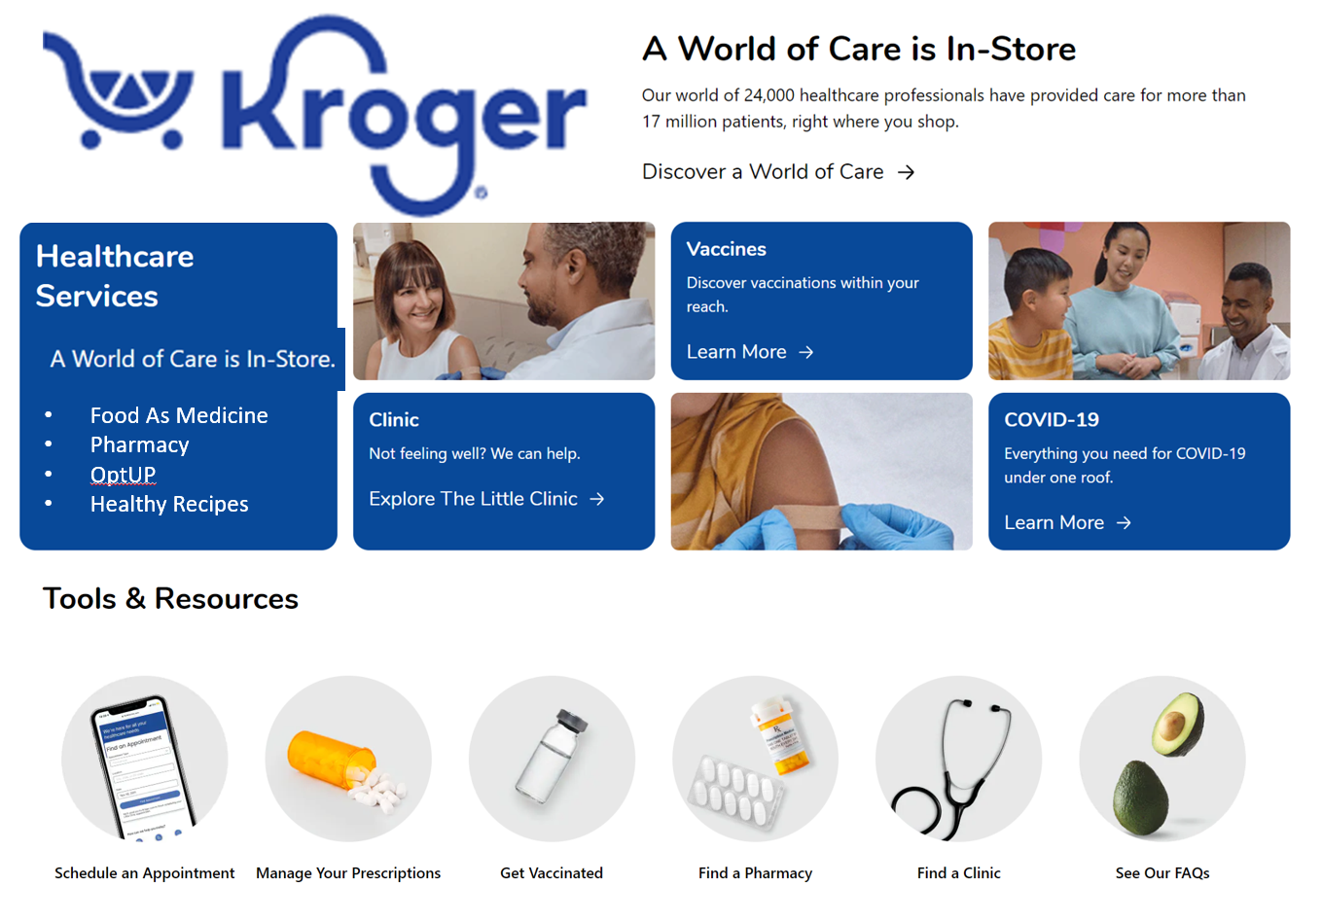
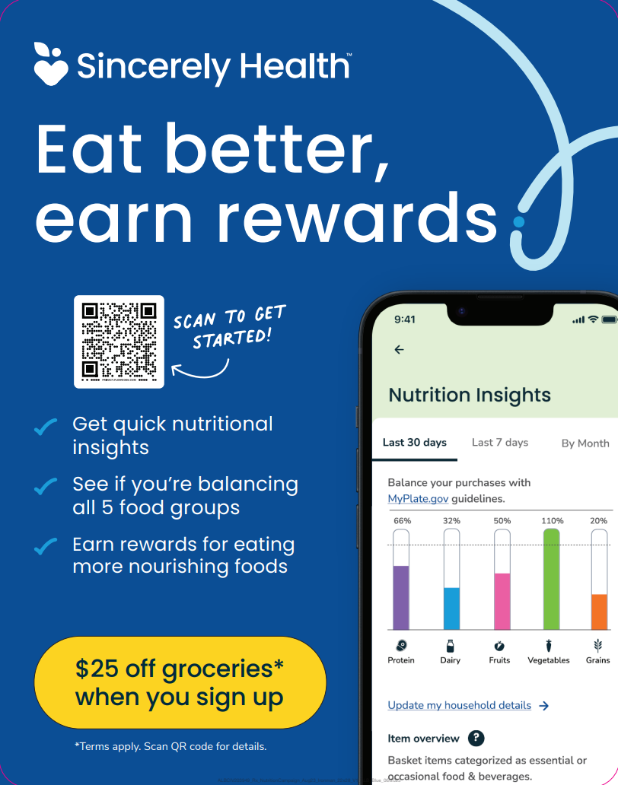
Watch for Merger of Kroger & Albertson’s to Create a Major Food-As-Medicine Player
Source: A world of care is in-store, Kroger press release, January 6, 2023
Source: Albertsons Companies Launches Nutrition Insights to
Sincerely Health Platform, August 16, 2023

Slide 23
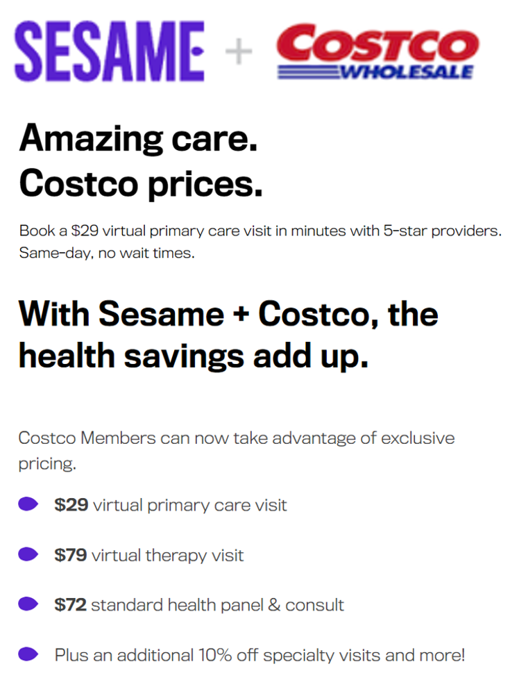

Slide 24
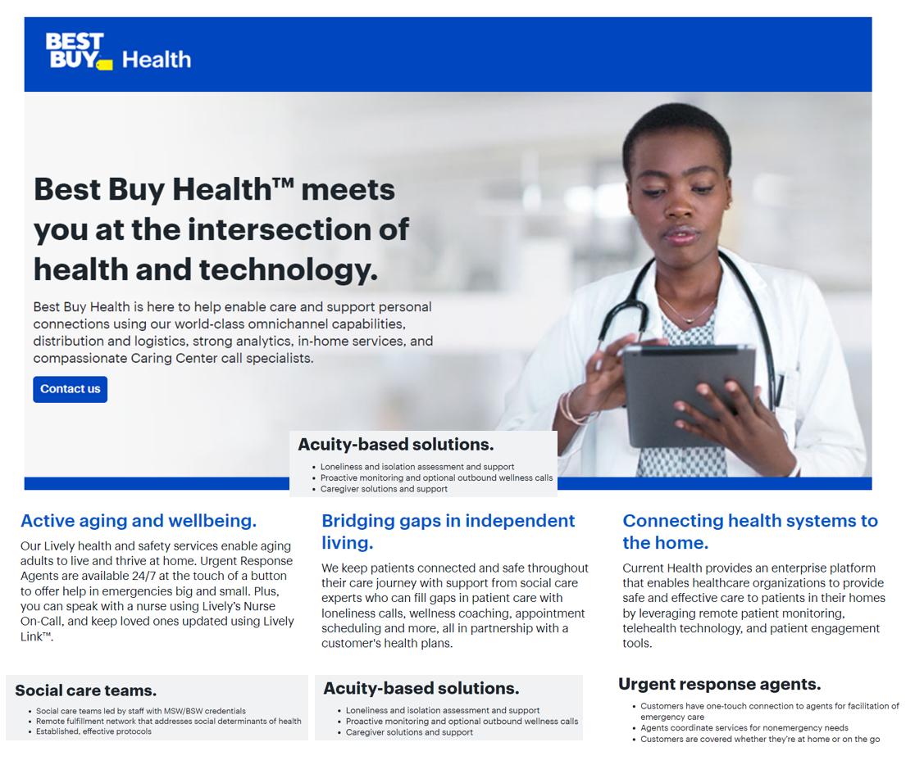
Evolution of
To expand at-home care
2018 – Great Call (phones & PERS)
2019 – Critical Signal Technologies; Partnerships w TytoCare (telehealth/remote exams), Workpath (phlebotomy), ScriptDrop (Rx delivery); in addition, collaboration with OSF HealthCare
2021 – Acquires Current Health
2022 – “Geisinger & the Geek Squad” (RHM)
2023 –Atrium Health (Geek Square to the home/wearable tech); in addition, collaborations with Mt Sinai Health System, NYU Langone Health, and Mass General Brigham
-- Agreement to sell prescribed CGMs (Dexcom G7 1st to channel).

Slide 25
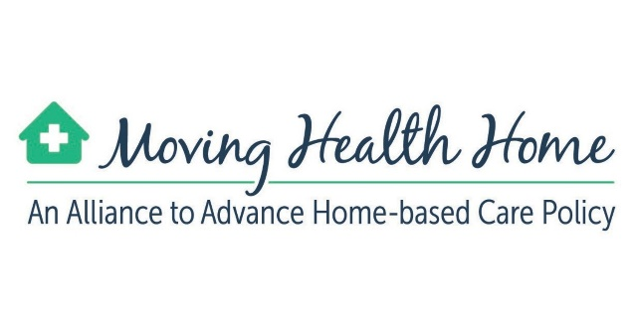
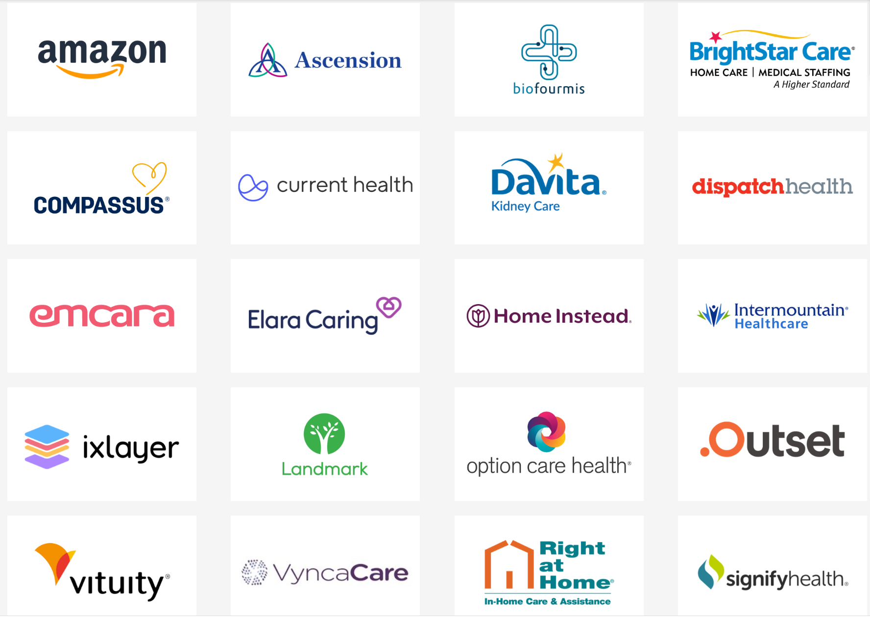
Members as of July 2023
Source: Leading Health Innovators Launch Alliance To Advance Care In The Home, press release, March 3, 2021;
member list updated July 6, 2023

Slide 26
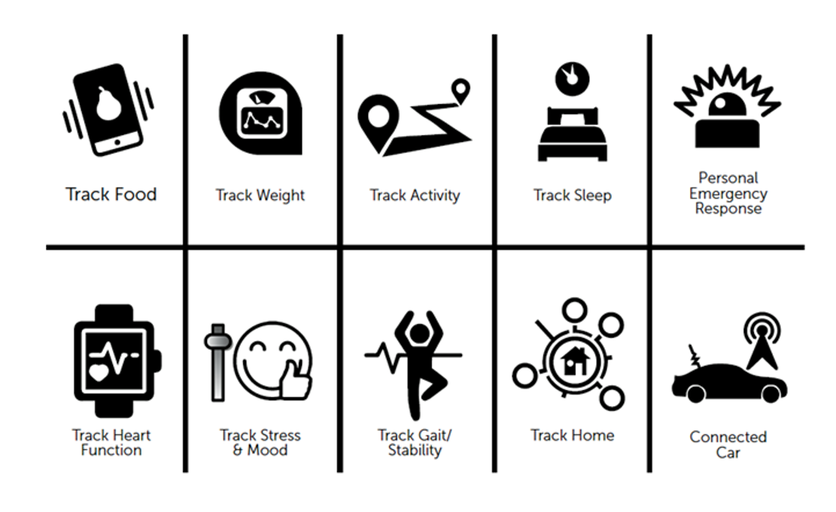
CES 2023: key categories in consumer-facing health devices
And the growth of the internet of things in health/care
Source: Jane S-K/THINK-Health curated at CES 2023, January 2023

Slide 27
Consumers expect all industries to engage in health
90%
90%
Q: For each industry, please indicate the ways in which you think it is important for that industry to engage in health…
Source: Edelman Health Barometer, 2010

Slide 28
The New healthcare Consumerism future drivers and prospects
Consider macroeconomics – future of Medicare, Medicaid, Social Security
Consider microeconomics of the household, by generation
Demand for self-care vs. a primary care medical home (watch Millennials, Gen Z)
Track growth of value-based payment among providers
Track supply-side of providers – physicians, nurses, pharmacists – burning out, dropping out, re-purposing their human capital
Monitor clinical evidence for wearable tech, RHM, digital tx
Some Big Questions to ponder…
The Future of Hospitals (and business models)?
Employer-sponsored health insurance?
Impact of social determinants of health on health equity and access?

Slide 29
Jane Sarasohn-Kahn, MA (Econ.), MHSA
Health Economist, Advisor, Trend Weaver
jane@think-health.com
www.healthpopuli.com Blog
@healthythinker
+1 (484) 695-7735

